Slide 1
Machine Learning
Dr.K DeviPriya

Slide 2
Machine Learning
Course Outcomes: At the end of this course, the student will be able to
CO1: Identify the characteristics of machine learning.(Understand- L2)
CO2: Understand the Model building and evaluation approaches.(Understand- L2)
CO3: Apply regression algorithms for real-world Problems.(Apply- L3)
CO4: Handle classification problems via supervised learning algorithms.(Apply- L3)
CO5: Learn advanced learning techniques to deal with complex data.(Apply- L3)

Slide 3
UNIT I
Introduction to Machine Learning - Introduction, Types of Machine Learning, Applications of Machine Learning, Issues in Machine Learning. Preparing to Model- Introduction, Machine Learning Activities, Basic Types of Data in Machine Learning, Exploring Structure of Data, Data Quality and Remediation, Data Pre-Processing(Text Book1-Saikat Dutt-Chapter1 ,Chapter2)

Slide 4
UNIT II Modeling & Evaluation- Introduction,
selecting a Model, training a Model (for Supervised Learning), Model Representation and Interpretability, Evaluating Performance of a Model. Basics of Feature Engineering- Introduction, Feature Transformation – Feature Construction, Feature Extraction, Principal Component Analysis (PCA), Singular Value Decomposition (SVD), Linear Discriminate Analysis (LDA), Feature Subset Selection

Slide 5
Selecting Model
Supervise or Predictive Models
Classification
Regression
Unsupervised or Descriptive Models
Clustering
Association Analysis

Slide 6
Training Model (For Supervised Learning)
Holdout Method
K-fold Cross-validation method
Bootstrap sampling
Lazy vs. Eager learner

Slide 7
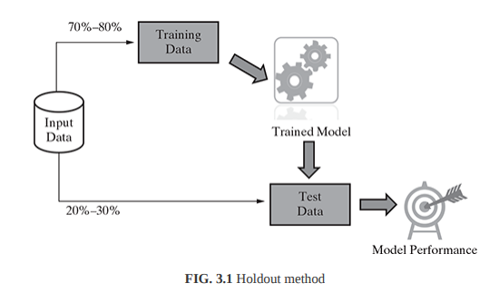
Holdout Method

Slide 8
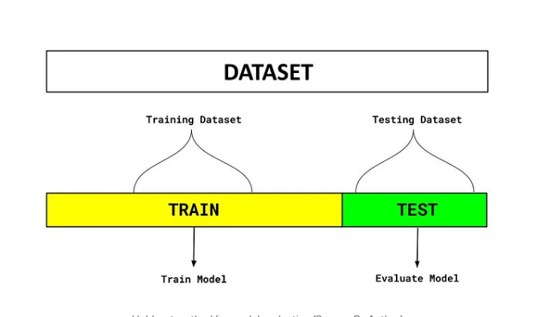
Holdout Method

Slide 9
Holdout Method
There are two parts to the dataset in the diagram above. One split is held aside as a training set. Another set is held back for testing or evaluation of the model.
The percentage of the split is determined based on the amount of training data available. A typical split of 70–30% is used in which 70% of the dataset is used for training and 30% is used for testing the model.
The objective of this technique is to select the best model based on its accuracy on the testing dataset and compare it with other models.

Slide 10
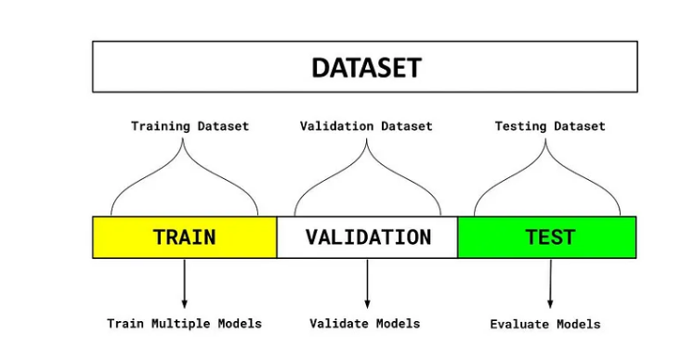
Holdout Method-train,vaildation,test

Slide 11
Holdout Method-train,vaildation,test
Train Dataset
Set of data used for learning (by the model), that is, to fit the parameters to the machine learning model
Valid Dataset
Set of data used to provide an unbiased evaluation of a model fitted on the training dataset while tuning model hyperparameters.
Also play a role in other forms of model preparation, such as feature selection, threshold cut-off selection.

Slide 12
Holdout Method-train,vaildation,test
Test Dataset
Set of data used to provide an unbiased evaluation of a final model fitted on the training dataset.

Slide 13
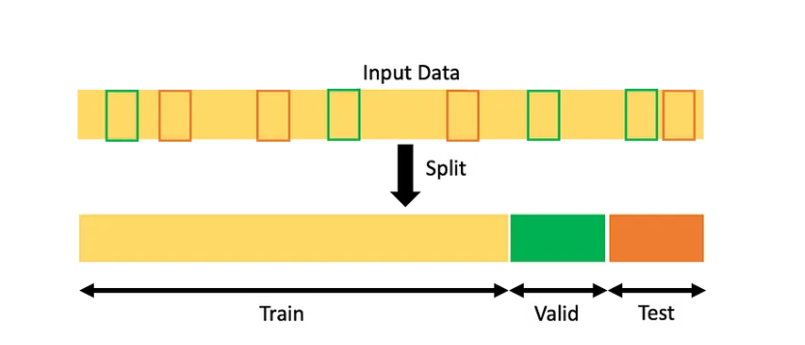
Holdout Method-train,vaildation,test

Slide 14
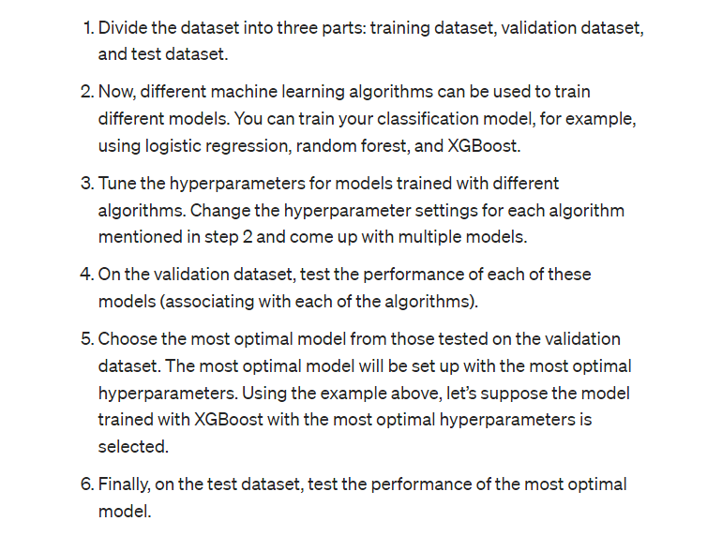
Holdout Method-train,vaildation,test

Slide 15
Holdout Method
sklearn.model_selection.train_test_split(*arrays, test_size=None, train_size=None, random_state=None, shuffle=True, stratify=None
from sklearn.model_selection import train_test_split
Link:
https://scikit-learn.org/stable/modules/generated/sklearn.model_selection.train_test_split.html
https://builtin.com/data-science/train-test-split

Slide 16
Python code
x_train, x_test, y_train, y_test = train_test_split( x, y, test_size=4, random_state=4 )

Slide 17
Python code
from fast_ml.model_development import train_valid_test_split
X_train, y_train, X_valid, y_valid, X_test, y_test = train_valid_test_split(df, target = target, train_size=0.8, valid_size=0.1, test_size=0.1) # Get the shape of all the datasets print(X_train.shape), print(y_train.shape) print(X_valid.shape), print(y_valid.shape) print(X_test.shape), print(y_test.shape)

Slide 18
Cross-validation
Cross-validation is a resampling procedure used to evaluate machine learning models on a limited data sample.
Resampling is a series of techniques used in statistics to gather more information about a sample. This can include retaking a sample or estimating its accuracy. With these additional techniques, resampling often improves the overall accuracy and estimates any uncertainty within a population.

Slide 19
Cross-validation
Cross-validation is a resampling procedure used to evaluate machine learning models on a limited data sample.
The procedure has a single parameter called k that refers to the number of groups that a given data sample is to be split into. As such, the procedure is often called k-fold cross-validation.23-May-2018

Slide 20
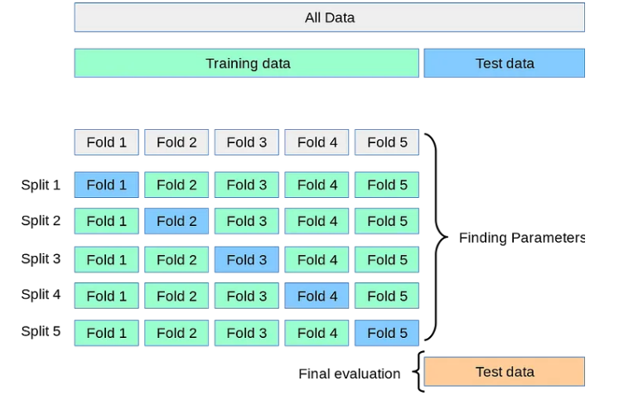
K Fold Cross Validation

Slide 21
. In k-fold cross-validation, the data set is divided into k-completely distinct or non-overlapping random partitions called folds. Figure 3.2 depicts an overall approach for k-fold cross-validation.

Slide 22
The value of ‘k’ in k-fold cross-validation can be set to any number. However, there are two approaches which are extremely popular:
1. 10-fold cross-validation (10-fold CV) 2. Leave-one-out cross-validation (LOOCV) 10-fold cross-validation is by far the most popular approach.

Slide 23
In this approach, for each of the 10-folds, each comprising of approximately 10% of the data, one of the folds is used as the test data for validating model performance trained based on the remaining 9 folds (or 90% of the data). This is repeated 10 times, once for each of the 10 folds being used as the test data and the remaining folds as the training data.The average performance across all folds is being reported. F

Slide 24
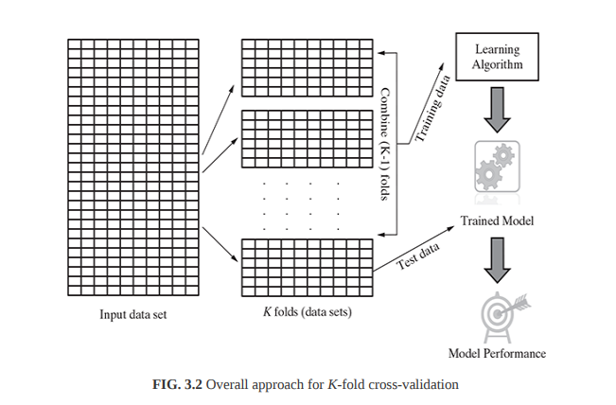

Slide 25
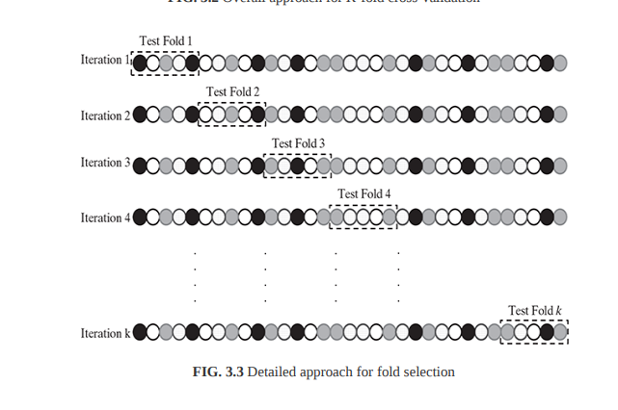

Slide 26
K Fold Cross Validation
https://isheunesu48.medium.com/cross-validation-using-k-fold-with-scikit-learn-cfc44bf1ce6

Slide 27
What is Bootstrap Sampling?
Resampling uses methods like the bootstrapping technique and permutation tests. With sampling, there are four main methods:
Simple random sampling: Simple random sampling is when every person or data piece within a population or a group has an equal chance of selection. You might generate random numbers or have another random selection process.
Systematic sampling: Systematic sampling is often still random, but people might receive numbers or values at the start. The person holding the experiment then might select intervals to divide the group, like every third person.
Stratified sampling: Stratified sampling is when you divide the main population into several subgroups based on certain qualities. This can mean collecting samples from groups of different ages, cultures or other demographics.
Cluster sampling: Cluster sampling is similar to stratified sampling, as you can divide populations into separate subgroups. Rather than coordinated groups with similar qualities, you select these groups randomly, often causing differences in results.

Slide 28
https://www.kdnuggets.com/2023/03/bootstrapping.html

